Slide 1
Pneumonia
The Center for Life Enrichment
Training
Resource: www.mayoclinic.com

Slide 2
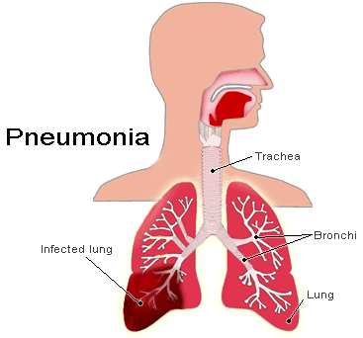
What is Pneumonia?
Pneumonia is an infection that inflames the air sacs in one or both lungs. The air sacs may fill with fluid or pus, causing cough with phlegm or pus, fever, chills and difficulty breathing
A variety of organisms, including bacteria, viruses and fungi, can cause pneumonia
Pneumonia can range in seriousness from mild to life-threatening

Slide 3
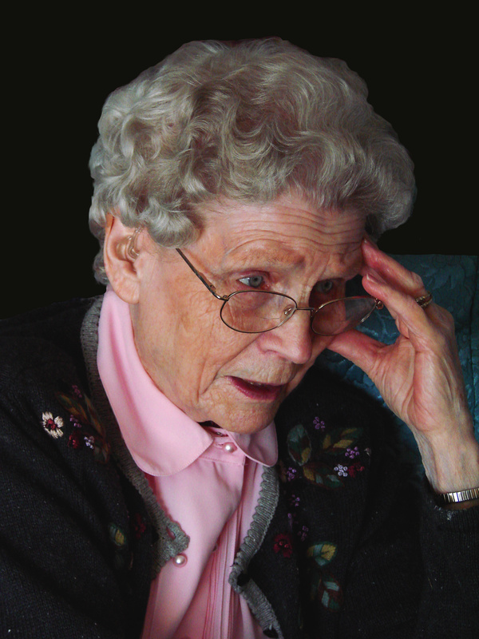
Who is Most at Risk?
Pneumonia can affect anyone. But the two age groups at highest risk are:
  People older than age 65
  Infants and children younger than age 2 years, because their immune systems are still developing

Slide 4
Other Risk Factors
Other risk factors include:
  Certain chronic diseases, such as asthma, chronic obstructive pulmonary disease and heart disease
  Weakened or suppressed immune system, due to factors such as HIV/AIDS, organ transplant, chemotherapy for cancer or long-term steroid use
  Smoking, which damages your body's natural defenses against the bacteria and viruses that cause pneumonia
  Being placed on a ventilator while hospitalized

Slide 5
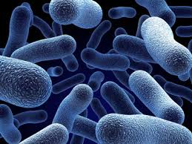
Causes of Pneumonia
Pneumonia has many possible causes
The most common are bacteria and viruses in the air we breathe. Your body usually prevents these germs from infecting your lungs. But sometimes these germs can overpower your immune system, even if your health is generally good
Pneumonia is classified according to the types of germs that cause it, and where you acquired the infection

Slide 6
Community-Acquired Pneumonia
Community-Acquired Pneumonia is the most common type of pneumonia. It occurs outside of hospitals and other health care facilities, and may be caused by bacteria, bacteria-like organisms, viruses, or fungi
  Bacteria—Bacterial community-acquired pneumonia can occur on its own or after you have a cold or respiratory flu. This type of pneumonia often affects one area (lobe) of the lung
  Bacteria-like organisms—typically produce milder signs and symptoms than do other types of pneumonia. "Walking pneumonia," a term used to describe pneumonia that isn't severe enough to require bed rest, may result from bacteria-like organisms
  Viruses—including some that are the same type of viruses that cause colds and flu. Viruses are the most common cause of pneumonia in children younger than 2 years. Viral pneumonia is usually mild. But viral pneumonia caused by certain influenza viruses, such as sudden acute respiratory syndrome (SARS), can become very serious
  Fungi—which can be found in soil and in bird droppings. This type of pneumonia is most common in people with an underlying health problem or weakened immune system and in people who have inhaled a large dose of the organisms

Slide 7

Hospital-Acquired Pneumonia
Hospital-acquired pneumonia is a bacterial infection that occurs in people 48 hours or more after being hospitalized for another condition
Hospital-acquired pneumonia can be serious because the bacteria causing it may be more resistant to antibiotics
People who are on a breathing machine (ventilator), often used in intensive care units, are at higher risk of this type of pneumonia

Slide 8
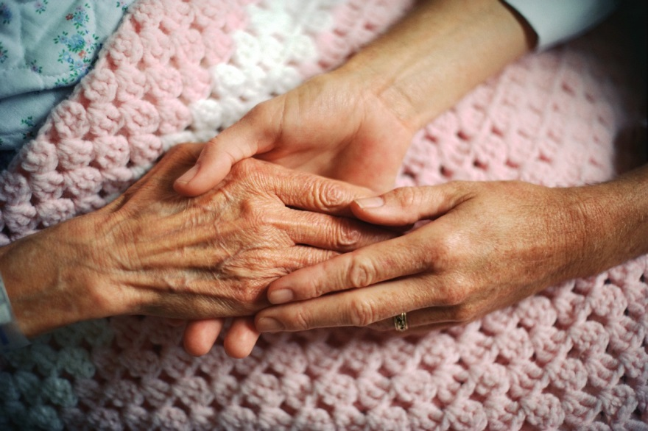
Health Care-Acquired Pneumonia
Health care-acquired pneumonia is a bacterial infection that occurs in people who are living in long-term care facilities or have been treated in outpatient clinics, including kidney dialysis centers
Like hospital-acquired pneumonia, health care-acquired pneumonia can be caused by bacteria more resistant to antibiotics

Slide 9
Aspiration Pneumonia
Aspiration pneumonia occurs when you inhale food, drink, vomit or saliva into your lungs
This aspiration may happen if something disturbs your normal gag reflex, such as a brain injury, swallowing problem, or excessive use of alcohol or drugs

Slide 10
Symptoms
The signs and symptoms of pneumonia vary from mild to severe, depending upon factors such as the type of germ causing the infection and your age and overall health
Mild signs and symptoms often are similar to those of a cold or flu, but they last longer
Newborns and infants may not show any sign of the infection. Or they may vomit, have a fever and cough, appear restless or tired and without energy, or have difficulty breathing and eating
Older people who have pneumonia sometimes have sudden changes in mental awareness

Slide 11
Common Signs and Symptoms
Fever, sweating and shaking chills
Lower than normal body temperature in people older than age 65, and in people with poor overall health or weakened immune systems
Cough, which may produce thick, sticky fluid
Chest pain when you breathe deeply or cough
Shortness of breath
Fatigue and muscle aches
Nausea, vomiting or diarrhea
Headache

Slide 12
When to See a Doctor
See your doctor if you have difficulty breathing, chest pain, persistent fever of 102 F (39 C) or higher or persistent cough, especially if you are coughing up pus
For some older adults and people with heart failure or lung ailments, pneumonia can quickly become a life-threatening condition
It's especially important to see a doctor if:
  A child with signs and symptoms is younger than age 2
  You are older than age 65
  You have an underlying health condition or weakened immune system
  You're having chemotherapy or taking medication that suppresses your immune system

Slide 13
Preparing for the Appointment
You may start by seeing a primary care doctor, or you may be referred to a doctor who specializes in infectious diseases or in lung disease (pulmonologist)
Here's some information to help you/the participant get ready for the appointment:
  Keep a record of any symptoms, including his/her temperature
  Write down key medical information, including recent hospitalizations and any medical conditions he/she has
  Write down key personal information, including exposure to any chemicals or toxins
  Make a list of all medications, vitamins and supplements that he/she is taking
  Accompany the participant to the appointment, if possible, to help him/her remember questions to ask and what the doctor said
  Prior to the appointment, write down questions to ask the doctor

Slide 14
Treatment
People who have community-acquired pneumonia usually can be treated at home with medication. Although your symptoms may ease in a few days or weeks, tiredness can persist for a month or more
To avoid making your condition worse:
  Don't smoke or be around smoke
  Drink plenty of fluids and get plenty of rest

Slide 15
Medication
Specific treatments depend on the type and severity of your pneumonia, and your age and overall health. The options include:
  Antibiotics, to treat bacterial pneumonia. It may take time to identify the type of bacteria causing your pneumonia and to choose the best antibiotic to treat it. Symptoms often improve within three days, although improvement usually takes twice as long in smokers. If your symptoms don't improve, your doctor may recommend a different antibiotic
  Antiviral medications, to treat viral pneumonia. Symptoms generally improve in one to three weeks
  Fever reducers, such as aspirin or ibuprofen
  Cough medicine, to calm your cough so you can rest. Because coughing helps loosen and move fluid from your lungs, it's a good idea not to eliminate your cough completely

Slide 16
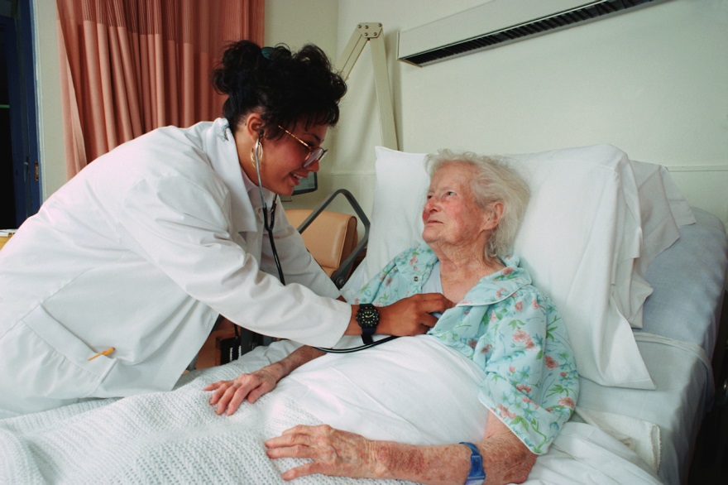
Hospitalization
You may need to be hospitalized if:
  You are older than age 65
  You become confused about time, people or places
  Your nausea and vomiting prevent you from keeping down oral antibiotics
  Your blood pressure drops
  Your breathing is rapid
  You need breathing assistance
  Your temperature is below normal
  If you need to be placed on a ventilator or your symptoms are severe, you may need to be admitted to an intensive care unit

Slide 17
Prevention
To help prevent pneumonia:
  Get a seasonal flu shot. The influenza virus can be a direct cause of viral pneumonia. Bacterial pneumonia is also a common complication of the flu. A yearly flu shot provides significant protection
  Get a pneumonia vaccination. Doctors recommend a one-time vaccine against Streptococcus pneumoniae bacteria (pneumococcus) for everyone older than age 65, as well as for people of any age residing in nursing homes and long-term care facilities, and for smokers. The vaccine is especially recommended for anyone at high risk of pneumococcal pneumonia. Some doctors recommend a booster shot five years after the first dose

Slide 18

More Prevention Tips
Practice good hygiene. To protect yourself against ordinary respiratory infections that sometimes lead to pneumonia, wash your hands regularly or use an alcohol-based hand sanitizer
Don't smoke. Smoking damages your lungs' natural defenses against respiratory infections
Stay rested and fit. Proper rest, a healthy diet and moderate exercise can help keep your immune system strong
Set an example. When you're in public and have a cold, catch your coughs and sneezes in the inner crook of your elbow

