Slide 1
Anaphylaxis & EpiPen Administration
CMT Training
The Center for Life Enrichment
Resource: MTTP Student Manual, www.epipen.com

Slide 2
Anaphylaxis
Anaphylaxis is a life-threatening allergic reaction that can occur quickly (as fast as within a couple of minutes)
It is usually caused by insect stings (bees, wasps, yellow jackets, etc.)
It can also be caused by an individual being exposed to an agent/allergen such as medications, food, latex, etc.
Administer the EpiPen as directed by a physician for anaphylactic reactions

Slide 3
Symptoms of Anaphylaxis
Symptoms of a life-threatening allergic reaction (anaphylaxis) vary, but may include:
Trouble breathing
Wheezing
Hoarseness (changes in the way your voice sounds)
Hives (raised reddened rash that may itch)
Severe itching
Swelling of your face, lips, mouth, or tongue
Skin rash, redness, or swelling
Fast heartbeat
Weak pulse
Feeling very anxious
Confusion
Stomach pain
Losing control of urine or bowel movements (incontinence)
Dizziness, fainting, or “passing out” (unconsciousness)

Slide 4
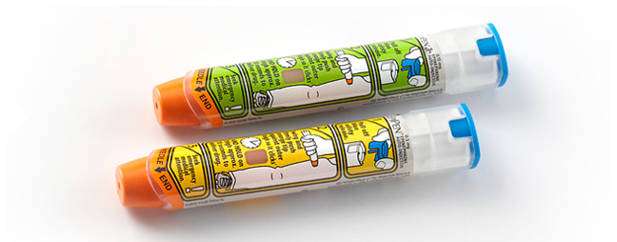
What is the EpiPen?
The EpiPen Auto-Injector is a disposable, prefilled automatic injection device used to treat life-threatening, allergic emergencies including anaphylaxis in people who are at risk for or have a history of serious allergic emergencies
Active Ingredient: Epinephrine
The EpiPen Auto-Injector (0.3 mg) is for patients who weigh 66 pounds or more
The EpiPen Jr Auto-Injector (0.15 mg) is for patients who weigh about 33 to 66 pounds
You do NOT need to be a Certified Medication Technician (CMT) to administer an EpiPen injection

Slide 5
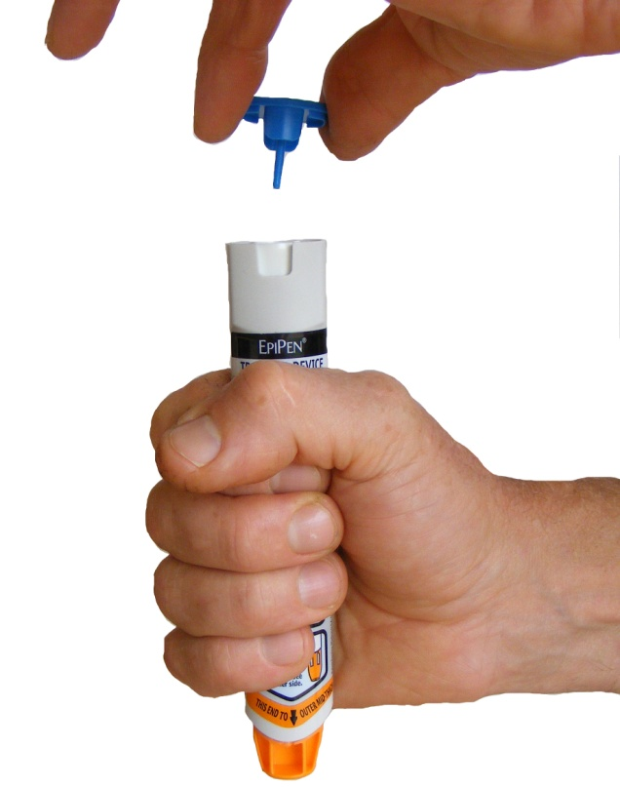
How to use the Epipen
If an individual exhibits signs/symptoms of an anaphylactic reaction, call 911!
Each EpiPen Auto-Injector contains only 1 dose of medicine
The EpiPen Auto-Injector should be injected into the muscle of your outer thigh. It can be injected through your clothing if needed
Use your EpiPen Auto-Injector exactly as your healthcare provider tells you to use it
Caution: Never put your thumb, fingers, or hand over the orange tip. Never press or push the orange tip with your thumb, fingers, or hand. The needle comes out of the orange tip. Accidental injection into finger, hands or feet may cause a loss of blood flow to these areas. If this occurs, go immediately to the nearest emergency room. Tell the healthcare provider where on your body you received the accidental injection

Slide 6
Important
Always carry your EpiPen Auto-Injector with you because you may not know when anaphylaxis may happen
When you have an allergic emergency (anaphylaxis) use the EpiPen Auto-Injector right away
Immediately after use of the EpiPen:
If not already contacted, call 911. The individual should be transported to the nearest emergency room for further medical evaluation
Contact the RN CM/DN
Tell the EMT/physician that the individual has received an EpiPen injection
Give the used EpiPen to the EMT/physician/nurse for inspection and proper disposal

Slide 7
How to Store the Epipen
Store at 68°to 77°F
Protect from light
Do not expose to extreme cold or heat. For example, do not store in your vehicle’s glove box and do not store in the refrigerator or freezer
Examine contents in the clear window of your auto-injector periodically. The solution should be clear. If the solution is discolored (pinkish or brown color) or contains solid particles, replace the unit
Always keep your EpiPen Auto-Injector in the carrier tube to protect it from damage; however, the carrier tube is not waterproof
The blue safety release helps to prevent accidental injection of the device. Keep the blue safety release on until you need to use it
Your EpiPen Auto-Injector has an expiration date. Replace it before the expiration date

Slide 8
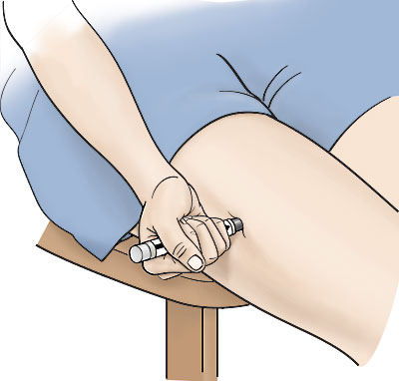
Practice with Trainer device
Your EpiPen Auto-Injector may come packaged with an EpiPen Auto-Injector Trainer and separate Trainer Instructions for Use
The EpiPen Auto-Injector Trainer has a grey color
The grey EpiPen Auto-Injector Trainer contains no medicine and no needle
Practice with your EpiPen Auto-Injector Trainer before an allergic emergency happens to make sure you are able to safely use the real EpiPen Auto-Injector in an emergency!
To sign-out an EpiPen Auto-Injector Trainer for practicing purposes, please see the RN at TCLE

