Slide 1
Abuse Prevention Training
The Center for Life Enrichment

Slide 2
Training Ground Rules
Everyone is valuable!
It’s okay to disagree on some things
Everyone needs a chance to participate
There are times when people don’t feel like talking
What happens here is private
It’s okay to be me, it’s not okay to be mean

Slide 3
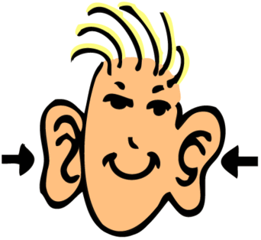
Rule #1: Everyone is valuable
How do you show someone they’re valuable?
LISTEN when they’re speaking
How do you show someone you care?
Be respectful
Be nice
Be a good friend

Slide 4
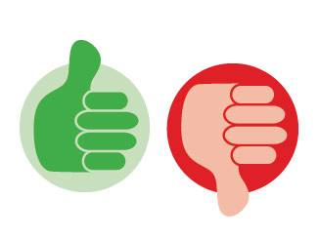
Rule #2: It’s okay to disagree on some things
Is it ever okay for someone to force you to do something you don’t want to do?
NO
What are some ways that people may try to force you into doing something that you don’t want to do?
Yell at you
Threaten you
Hit, push, or kick you
Is it okay for people to yell or hit you (use verbal or physical force)?
NO

Slide 5
Rule #3: Everyone needs a chance to participate
It is important to let everyone participate because it makes them feel good and valuable
How would it make you feel if another person didn’t let you have a chance?
Sad
Mad

Slide 6
Rule #4: There are times when people don’t feel like talking
If you don’t want to talk right now, staff will give you space
Staff are here if you want or need to talk about something

Slide 7
Rule #5: What happens here is private
You can ask questions, share your feelings, and talk openly in this training
Do not gossip with others about things you hear in this training

Slide 8
Rule #6: It’s okay to be me, it’s not okay to be mean
Be respectful
Listen when someone is speaking
Don’t talk when someone else is speaking

Slide 9
Feelings
There are 4 basic feelings:
Glad
Sad
Mad
Scared
What makes you feel glad?
What makes you feel sad?
What makes you feel mad?
What makes you feel scared?

Slide 10
Uncomfortable Feeling
If you have an uncomfortable feeling, you can talk to someone about it
If you had an uncomfortable feeling, who is someone in your life that you could talk to?
If something was wrong, who could you talk to?
Who would you tell if someone hit you?
Who would you tell if staff called you a bad name?

Slide 11
You are the expert on how you feel!
No one can tell you how you should feel
Only you know how you are feeling

Slide 12
Say No To Abuse
View the video:
“Say No To Abuse”
https://www.youtube.com/watch?v=NBioPN46j4Q
START the video at the beginning & STOP at 14:10
PLEASE NOTE!
In regards to the scene with Jenny, it is NOT financial abuse if Jenny’s parents were looking after her money to pay Jenny’s bills, care for her needs (food, shelter, etc.). It is okay for your parents or a trusted person to help you budget and handle your money.

Slide 13
Say NO
Your whole body is private, unless you say it’s okay
If a coworker rubs your leg, what should you say?
Say NO
What if “NO” doesn’t stop your coworker?
Tell someone you trust right away (i.e. supervisor at work, staff, family, caregiver, etc.)
What if telling someone you trust doesn’t stop your coworker?
Call the police

Slide 14
Say NO
If someone you don’t know asks if you want a ride, what do you do?
Say NO as loud as you can
A stranger or someone you don’t know very well should be an arm’s length away
Hold out your arm to see the proper distance between you and a stranger/someone you don’t know very well
Some strangers in the community are safe to talk to
If you were in trouble, would it be okay to talk to a police officer if they were a complete stranger?
Yes
People in uniforms are staff to the community and safe to talk to:
Police, Paramedics, Doctor, Nurse, Firefighter, Security Guard, etc.

Slide 15
Know Your Body Parts
Female Body Parts:
Hair
Eyes
Nose
Mouth
Ears
Breasts
Nipples
Belly Button
Vulva (Vagina)
Pubic Hair
Buttock (Anus)
Can you name any others?
Male Body Parts
Hair
Eyes
Nose
Mouth
Ears
Chest
Nipples
Belly Button
Penis
Pubic Hair
Scrotum (Testicles)
Buttock (Anus)
Can you name any others?

Slide 16
Your whole body is private, unless you say it’s okay!

Slide 17
Abuse in the Workplace
View the video:
“Everyone's Responsibility: Preventing Abuse Against People with Disabilities”
https://www.youtube.com/watch?v=Ps0Rt9TU3ao
START the video at the beginning & STOP at 9:10

Slide 18
Respect, Gentle Care, & Boundaries
While at TCLE, in the community, and at home, you have the right to gentle care
When people (including staff) are not respectful or gentle, say NO & tell someone you trust right away (i.e. supervisor at work, another staff, family, caregiver, etc.)
While at TCLE, in the community, and at home, you have a right to be spoken to with respect
If someone yells at you or calls you a name, tell them to stop & tell someone you trust right away (i.e. supervisor at work, another staff, family, caregiver, etc.)
While at TCLE, in the community, and at home, it is your right to feel safe and have your boundaries and routines respected

Slide 19
Respecting Boundaries
View the video:
“Everyone's Responsibility: Preventing Abuse Against People with Disabilities”
START the video at 30:05 & STOP the video at 34:50
https://www.youtube.com/watch?v=Ps0Rt9TU3ao

Slide 20
Your whole body is private, unless you say it’s okay!
If you say it’s okay, then what?
View the video:
“In My Voice: Sexual Self- Advocacy”
https://www.youtube.com/watch?v=M5Q5hW62M4Y

Slide 21
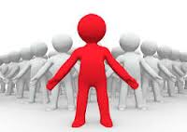
“Pledge of Personal Power” by Dave Hingsburger
I am unique.
There is only one me.
I am different from everyone else.
No one has a right to hurt me.
No one has a right to call me names.
My body is my own.
My mind is my own.
My heart is my own.
I will keep myself
PROTECTED
POWERFUL
PROUD
When I need to, I will say
NO! Back off! Leave me alone!
I will take care of myself.
I will take care of everyone here.

Slide 22
Questions?

